Slide 1
COMP 3311 Database Management Systems
Lab 2. Basic SQL statements

Slide 2
Objectives of the Lab
After this lab you should be able to
Know how to issue simple SQL commands to the SQL Developer
Know how to use the SELECT-FROM-WHERE SQL clause.
Know how to use the ORDER BY options in SQL clauses.
Know how to use simple Join clauses

Slide 3
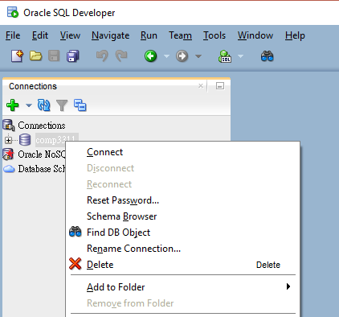
Re-connect to database server
Connect to UST network if using your own laptop
Right click on the connection
Click Connect
Enter your Oracle username and password

Slide 4
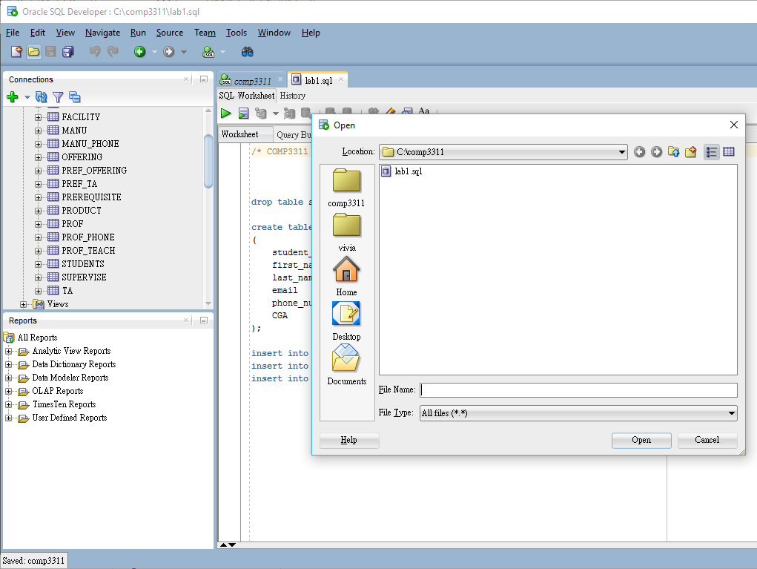
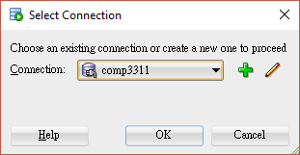
Running a SQL script file 1
Download (save) the lab2.sql file to local file system
Open file
Run script
Choose connection
1
4
2
3

Slide 5
Running a SQL script file 2
The table ‘students’ (if any) created last time in your database was dropped (i.e. deleted), a new ‘students’ and a ‘departments’ tables are created.
First, lab2.sql creates a table called ‘students’ with 7 attributes and a table called department with 3 attributes.
Then, lab2.sql inserts 5 different student records into the table ‘students’ and 3 different records of departments into the table ‘departments’.
We will cover more SQL details in the future labs.

Slide 6
Running a SQL script file 3
You should get below result in Script Output after successfully run lab2.sql
Table STUDENTS dropped.*
Table DEPARTMENTS dropped.
Table STUDENTS created.
1 row inserted.
1 row inserted.
1 row inserted.
1 row inserted.
1 row inserted.
Table DEPARTMENTS created.
1 row inserted.
1 row inserted.
1 row inserted.
* If no STUDENTS table in the database before, warning message may appear. But no worry!

Slide 7
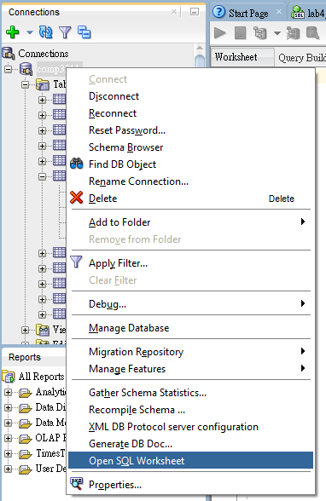
Run SQL statement
Switch to worksheet or open new worksheet
Type statements in worksheet
Keep the cursor on this line and run statement
Result will be shown in Query Result or Script Output

Slide 8
Retrieving records using the SELECT statement
Syntax: SELECT * | { [DISTINCT] column | expression [alias],..} FROM table
Example, select all the columns from a table: SELECT * FROM departments;
Example, select some specified columns SELECT department_id, name FROM departments;

Slide 9
Incorporating arithmetic operations to the SELECT statement
It is possible to include arithmetic operations like * , / , + , - to the SELECT statement.
For example: SELECT last_name, CGA, CGA+2.0 FROM students; SELECT last_name, CGA, CGA/2.0 FROM students;
Note that CGA/2.0 will return the same result as CGA/2 in SQL, this is different from some higher level languages like C++.

Slide 10
Changing the name of a column using Alias
We can change the column name of a table in the returned results by using the AS operator. SELECT last_name AS ln FROM students;
Use the SELECT statement to output a column named “ Quarter CGA ” which displays the result CGA/4. SELECT CGA/4 AS "Quarter CGA" FROM Students;

Slide 11
Removing duplicates
The default setting for the SELECT statement is to return all the relevant records – including duplicated ones. For example, the following statement will return all the department_ids from the students table: SELECT department_id FROM students;
To remove duplications, we can add the “ DISTINCT ” switch to the SELECT statement: SELECT DISTINCT department_id FROM students;

Slide 12
Concatenating results in the SELECT statements
Concatenating two columns in a select statement by using the “ || ” operator. SELECT first_name || last_name AS "Full Name" FROM students;
Adding a string to the results. SELECT last_name|| ' studies in ' || department_id AS "Description" FROM students;

Slide 13
Example of concatenations
By using concatenations, we can express the results from a query in a more easy-to-comprehend form.
For example we can artificially make an output from the table students to be:
Rita Lai(3456789) from the COMP department obtains CGA 10.5. His/Her email is cs_lrx@stu.ust.hk .
What is the corresponding SELECT statement?
SELECT first_name||' '|| last_name || '(' || student_id || ') ' || 'from the ' || department_id || ' department obtains CGA ' || CGA ||'.' ||' His/Her email is ' || email || '@stu.ust.hk .' AS lab2 FROM students;

Slide 14
Specifying the output by using the WHERE clause
The WHERE clause does not exist by itself, it is almost always in connection with the SELECT statement.
Syntax:
SELECT * | { [DISTINCT] column | expression [alias],..} FROM table WHERE conditions;
For example, we can retrieve only the information from the COMP department. SELECT * FROM departments WHERE department_id = 'COMP'; The string ‘COMP’ in the condition clause is case sensitive.

Slide 15
Using Comparison Operator with the WHERE clause
=,>,>=,<,<=,<>
Examples:
SELECT * from students WHERE CGA<>10.5;
SELECT * from students WHERE CGA>=10.5;
SELECT * from students WHERE CGA<=10.5;
SELECT * from students WHERE department_id='COMP';

Slide 16
Logical conditions
AND
WHERE cga>=10 AND department_id ='MATH'
OR
WHERE cga>10 OR department_id='MATH'
NOT
WHERE department_id NOT IN ('COMP' , 'ELEC')

Slide 17
More conditions
BETWEEN
WHERE cga BETWEEN 10 AND 12 (reversing the order of 10 and 12 will give you nothing)
IN
WHERE department_id in ('ELEC' , 'MATH')
LIKE
WHERE first_name LIKE '%i%’ i.e. ‘Linear’, ‘ill’ and ‘waive’ will be matched
WHERE first_name LIKE '_i%’ i.e. only ‘Linear’ will be matched but not ‘ill’ and ‘waive’ %: can have zero or more characters _: exactly one character.
IS NULL
WHERE last_name IS NULL

Slide 18
Changing precedence using Parentheses 1
THE AND condition has higher precedence than the OR condition
The following selects students from the COMP department plus the students from the MATH department with CGA>11:
SELECT * FROM students WHERE department_id= 'COMP' OR department_id= 'MATH' AND CGA>11;

Slide 19
Changing precedence using Parentheses 2
What if we want to select students with CGA >11, from either the ‘COMP’ or the ‘MATH’ departments? (Add a pair of parentheses)
SELECT * FROM students WHERE (department_id= 'COMP' OR department_id= 'MATH') AND CGA>11;

Slide 20
The ORDER BY clause
Sort the result by one or more columns
ASC : ascending order (default )
DESC: descending order
Examples: SELECT * FROM students ORDER BY cga; SELECT * FROM students ORDER BY cga DESC;

Slide 21
More about the ORDER BY clause
Sort by an alias SELECT first_name, CGA*0.8 AS wCGA FROM students ORDER BY wCGA;
Sort by multiple columns SELECT * FROM students ORDER BY department_id ASC, first_name DESC;

Slide 22
SQL JOINS
CROSS product in the absence of JOIN predicate: SELECT first_name, last_name FROM students, departments; The students table has 5 entries, the departments table has 3 entries, and we have 15 entries for this query.
JOIN
SELECT first_name, last_name from students, departments where students.department_id=departments.department_id;

Slide 23
SQL JOINS : Natural Join 1
Joins two tables.
The Natural-Join operation matches the rows of the two tables by looking at the column(s) with identical name(s).
The rows from the two tables are merged if the column entry/entries match(es).

Slide 24
SQL JOINS : Natural Join 2
For the tables students and departments, there is one such column department_id
Only rows with identical entries in the column department_id will be merged, so students with department_id=‘COMP’ will merge with the department with department_id=‘COMP’. SELECT first_name, department_id, name from students NATURAL JOIN departments;

Slide 25
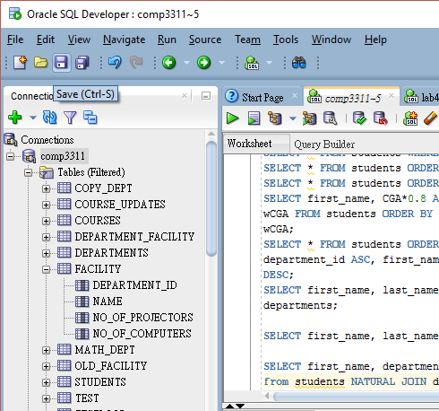
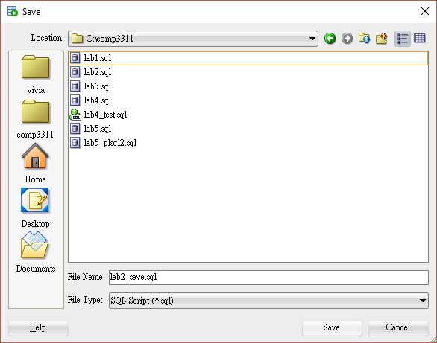
Saving SQL worksheet

Slide 26
Conclusions
We covered the following topics in this lab:
The SELECT statement.
Arithmetic operations in the SELECT statement.
Alias and Concatenation of results.
The WHERE clause, the comparison operators and the logical operators.
The ORDER BY clause.
The JOINs.

Slide 27
Exercise
Create queries according to the following requirements:
Display the first_name and email of the students from the COMP department.
Display the first_name of all the students whose first_name contains ‘ r ’ as the 4th character.
Display the first_name of all the students whose first_name contains either an ‘ a’ or an ‘e’.
Display the information for the students who are from (the COMP or the ELEC department) and the CGA is not 8.34 or 12.

